Slide 1


Railway Booking System
Prepared by:
Name: Rana Mahek Tejas(23002171310135)
Batch: B3 Branch: CST

Slide 2
Project Outline
Purpose of the project
System design diagram (Flowchart)
Class diagram or ER Diagram
Use case Diagram
Functionalities
Used DATA Structures and class
Tools used
Merits & Demerits
Future Scope

Slide 3
Functionalities of project Related with Particular Subject
Data Structures using JAVA | JAVA - II | DATABASE MANAGEMENT
1. Linked List is used for storing passenger details. | Exception Handling. | 1. Procedure is used to load train schedule from database.
2. Hash map to store key-value pairs. | 2. Collections Framework and OOP Concept(Classes and Object). | 2. Trigger is used to store inserted, updated and deleted old value to a table.
3. Tree Map Stores train schedules sorted by a combined key of travel date and departure time. | 3. File I/O concept. | 3. Inner join is used for fetch and display passenger details and Foreign key used in data base table .

Slide 4
Purpose of the project
Facilitates the passenger to enquiry about trains availability on the basis of source and destination .
Ticket booking.
Cancel booking.
Maintaining database to reduce the manual error.
Convenient for customer to maintain data about their train schedule.

Slide 5
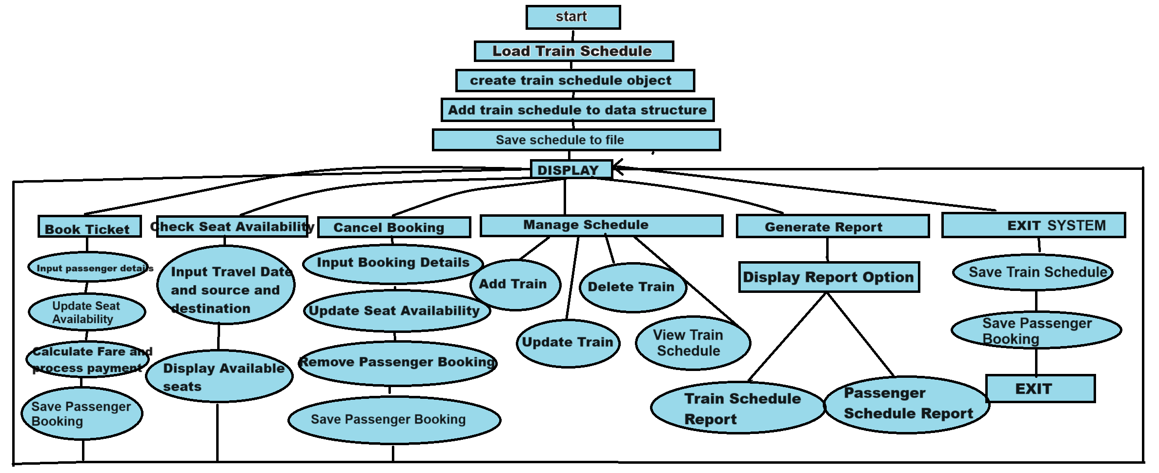
FLOW CHART
Exit

Slide 6
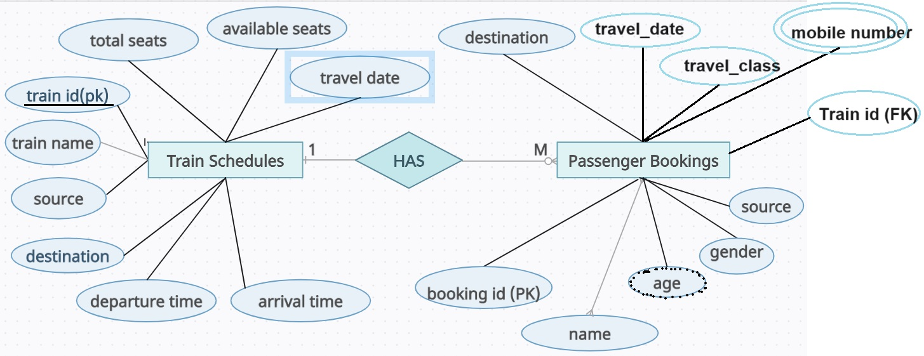
ER DIAGRAM

Slide 7
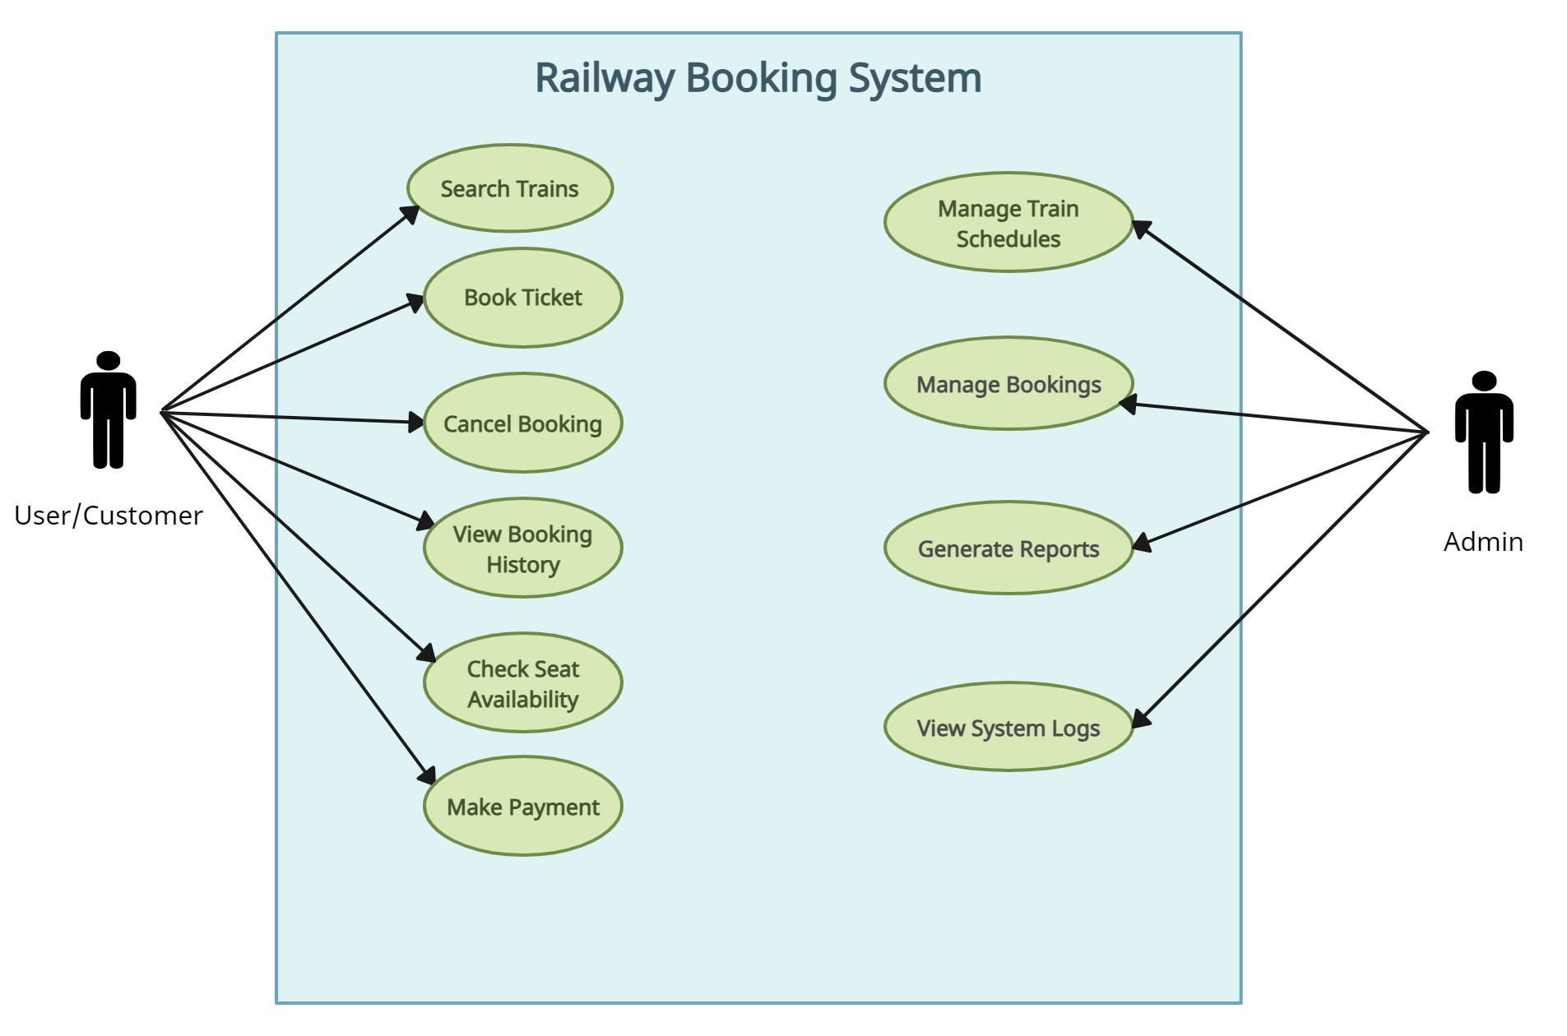
USE CASE DIAGRAM
Fetch and display passenger details

Slide 8
FUNCTIONALITIES
Booking Management
Schedule Management
Checking seat availability
Passenger Data Management
Booking Cancellation
Fare Calculation and Payment Processing
Report Generation
User Interaction
Exception handling

Slide 9
Used data structure and class
Linked list: For storing passenger details.
Hash Map: For storing key-value pairs.
Tree Map: For sorting trains based on travelling date departure time.

Slide 10
Tools Used
Visual studio code is used for coding purpose.
Xampp control panel is used .
Java database connectivity are used to interact with a phpMyAdmin database.
Paint and other ai tools is used to create diagram.
Referred drive notes of sem-1 and sem-2.

Slide 11
Merits and Demerits
Merits
Easy to use by implementing Array List and Hash Set.
Provide flexibility and efficient ways to store and manage data.
Using file I/O concept allows data to be saved and retrieved from files.
Implementing custom data structures provides a deeper understanding of how built-in structures work.
User interactive.
Demerits
Code complexity
Redundancy
Potential bugs

Slide 12
Future Scope
Develop a GUI using JavaFX or swing to enhanced user interface.
Advanced data structures and algorithms.
Develop a mobile application for booking and managing train tickets on-the-go.
Add support for multiple languages and regional settings to cater to a global user base.

Slide 13
Thank You

